Slide 1
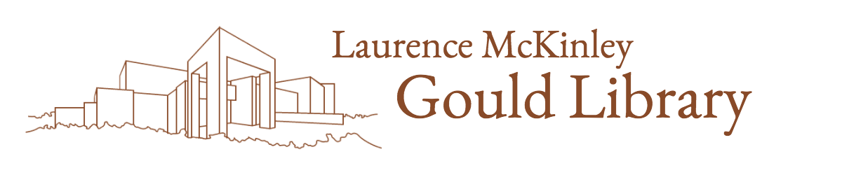
Text Handling
Brought to you by the Gould Library Data Services

Slide 2
The Process of Handling Data in R
Morpheme Analyzer
Load Data
Text Handling
(Create Corpus)
Create DTM
Data Search
Keyword Analysis
Keyword Network
Topic Analysis
Classification

Slide 3
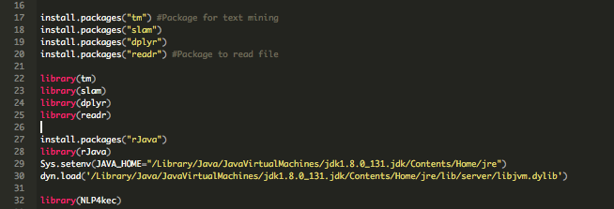
Read from R
Use package “readr” to read the file

Slide 4
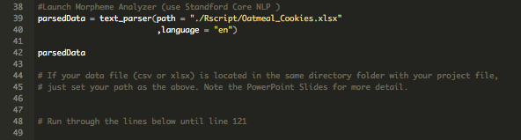
How to call your file
Note that your data file should be located in the same directory folder within your project file.
This process takes some time depending on the file size (the number of words)

Slide 5
What is tm package and how to use tm package?
tm package is used for text pre-processing
The following is the necessary step you need to do for for text pre-processing:
Create corpus
Remove punctuation and special characters and numbers
Change to lower case letters
Remove particular words: such as is, the, or, and, etc (words that you don’t want to analyze or words that have no special context/meaning)
Manage synonyms
Text pre-processing can be boring and complicating but it is a necessary process
Managing synonyms is particularly important
If the outcome of your analysis lacks something or if something went wrong, make sure your text pre-processing was done right
Text preprocessing is done with the tm package by creating a corpus (note the R script)
Make sure you don’t have any spaces in between letters

Slide 6
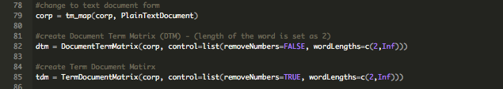
tm package - Document Term Matric
In order to do text mining, we have to create a basic data set
Document Term Matrix is a table that counts the number of used words in a particular document
Each row represents the document and the column represents the words (when it is reversed, it is called Term Document Matrix)
Document Term Matrix is an advanced level matrix; hence, words that appeared less frequently (also called as sparse term) should be deleted in order to shrink the size of the matrix
You can also use tf-idf (a numerical statistics that reflect how important a word is to a document) to lower the size of the matrix

Slide 7
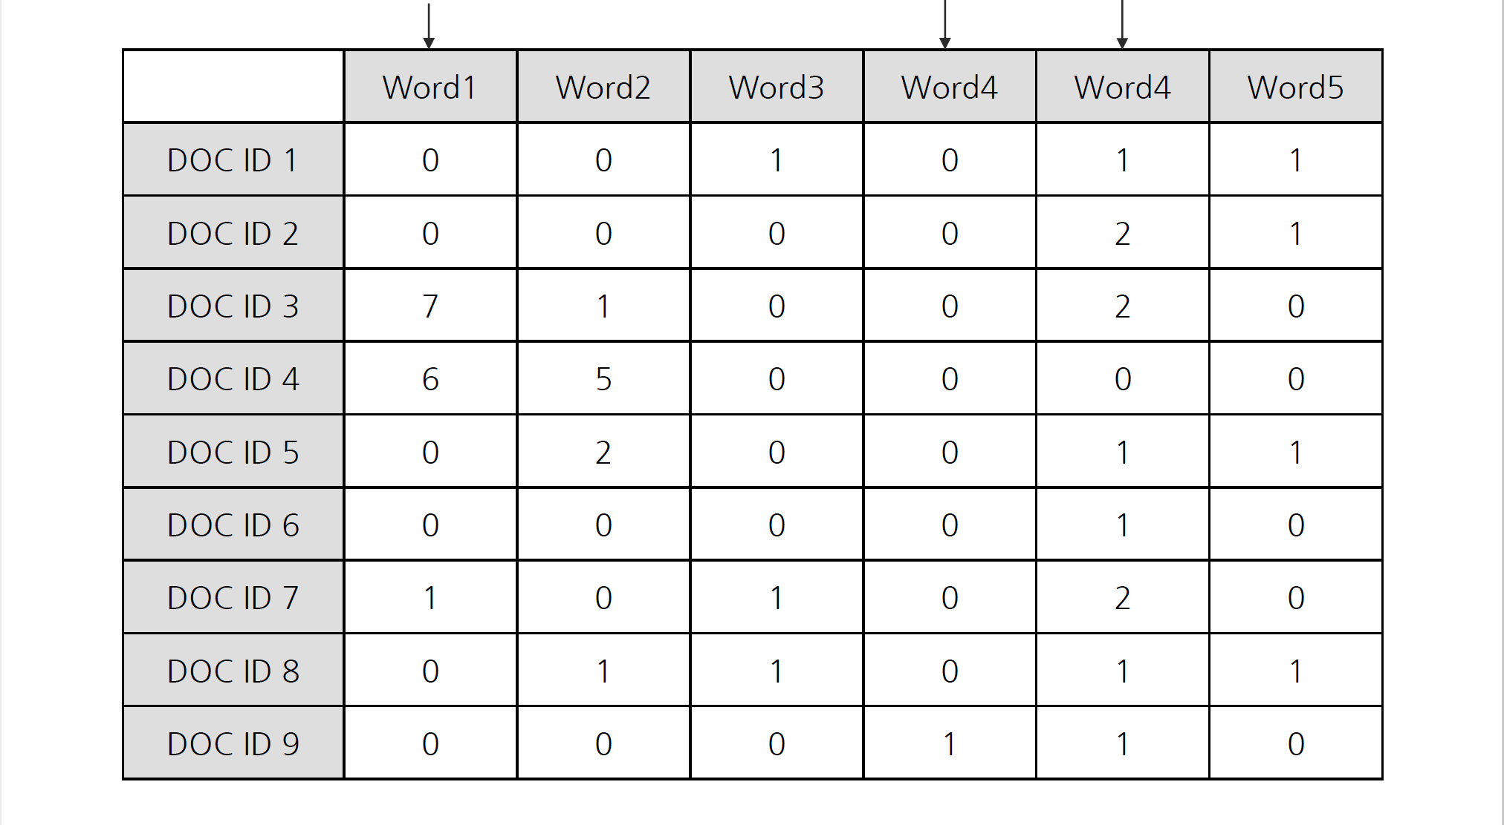
Example of Document Term Matrix
Word that appears in a particular document
Word that is not used that much
Common words

Slide 8
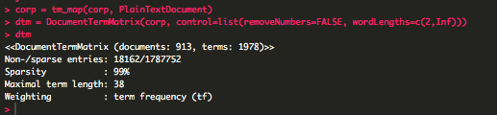
tm package - Document Term Matric 2
How to read DTM information?
type dtm in the console and you will get the following information:
documents: 913 (the total document number), terms: 1978 (the total number words)
Non-sparse entries: The number of cells without 0 / The number of cells with 0
Sparsity: 99%: The percentage of cells with 0
Maximal term length: The longest number in length
Weighting: The type of weight – either tf or tfidf

Slide 9
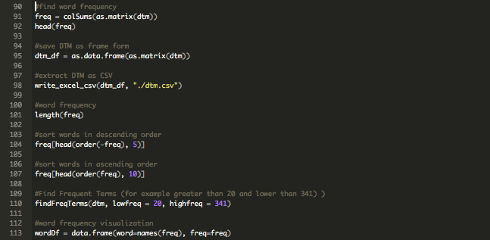
tm package – Explore Text Data
This is where we find the frequency using the freq function.
We explore the words’ frequency or words with high frequency
Check whether there are any useless words that needs to be taken away.
If there are any: we have to pre-process our text data

Slide 10
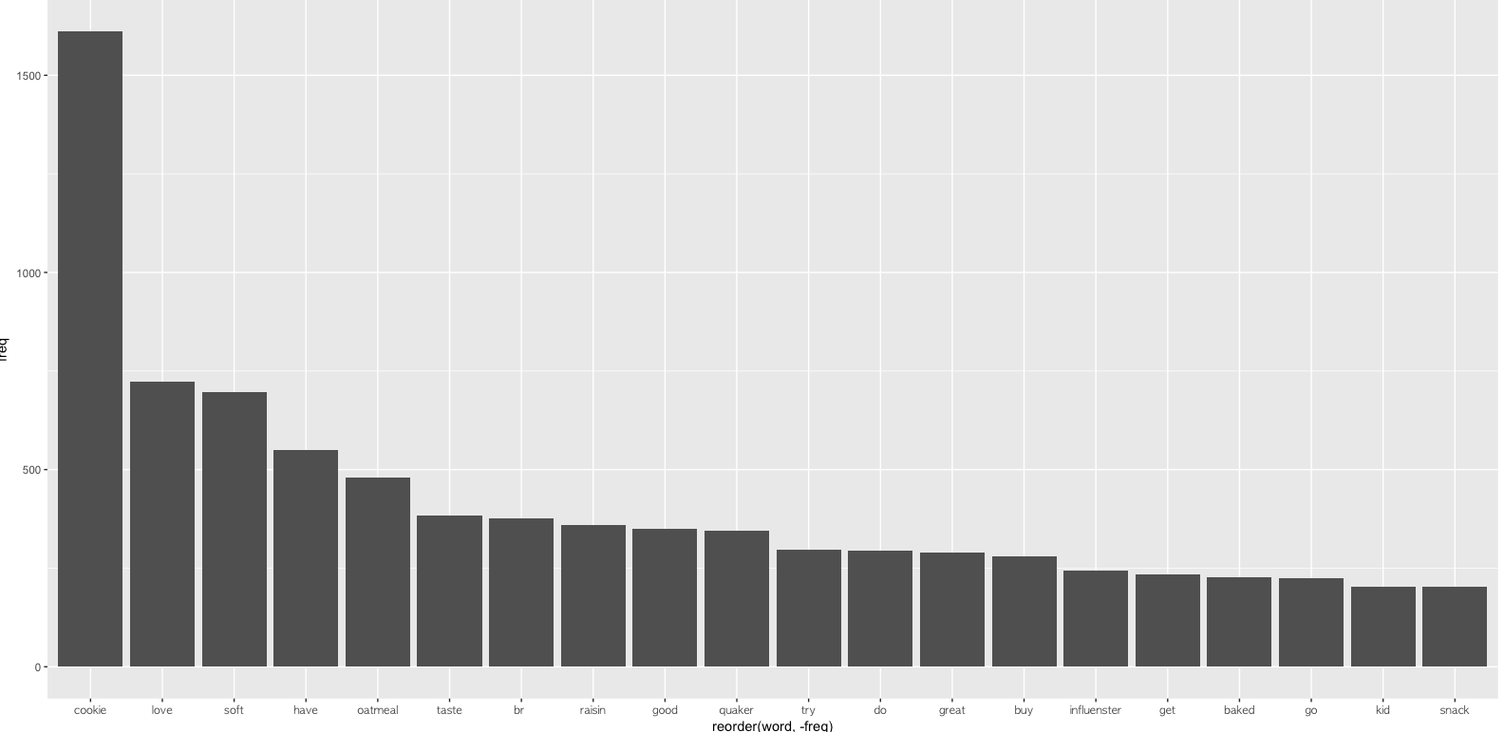
tm package – Explore Text Data: barChart
Use the bar chart to visualize the word frequency
Carefully follow through the steps in the r script and play around with it.

Slide 11
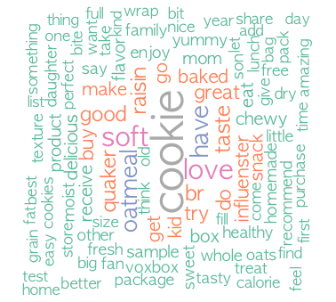
tm package – Explore Text Data: barChart
Use the word cloud – another way to visualize the word frequency
Note that you can change the color, font size (the value of the each scale) and control the overall shape of the word cloud
Note the r script and play around with it.

Slide 12
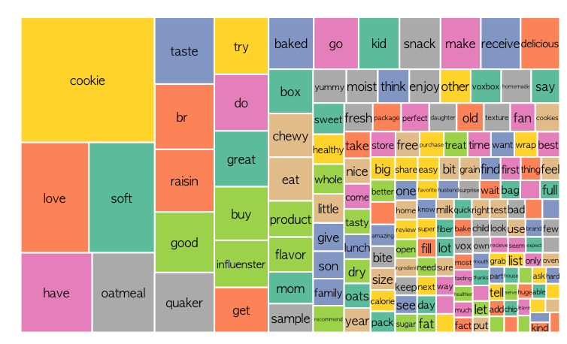
tm package – Explore Text Data: treeMap
The tree map also represents each word’s frequency
The size of the rectangle area represents the word’s frequency
If there is a level structure in the word, the tree map can represent the level structure as well

Slide 13
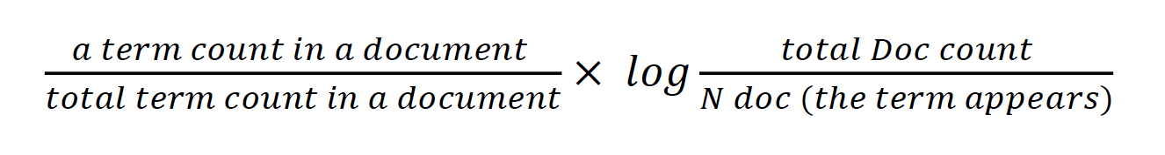
What is TF-IDF?
We briefly mentioned about TF-IDF in the previous slide but what is it exactly?
TF-IDF represents Term Frequency-Inverse Document Frequency and it is a numerical statistic that reflects how important a word is to a document in a collection or corpus.
TF is the frequency of a particular word in a document. Normally, if the TF value is high, one would assume it as an important word but at the same time it can be a word that simply has a high level of frequency with little importance. Words such as “is”, “do”, “like” are some examples.
In order to complement TF, we use DF. Words such as “is”, “do”, and “like” are common words with little importance. Hence, these words’ DF value will be high, which indicates that the words are less important.
Hence, we can know that a particular word is important if the value of IDF (DF’s inverse value) multiplied by our TF is high.
The following is the formula to find the TF-IDF value:

Slide 14
Examples of TF-IDF:
DOC 1
DOC 2
DOC 3
Word | Frequency
big data | 2
future | 1
important | 2
love | 3
Word | Frequency
text | 3
big data | 1
R | 3
love | 2
Word | Frequency
country | 2
dust | 1
serious | 2
love | 2
“text” TF-IDF value
tf(“text”, DOC1) = 0/8 = 0
tf(“text”, DOC2) = 3/9 = 0.33
tf(“text”, DOC3) = 0/9 = 0
idf(“text”) = log(3/1) = 1.099
TF-IDF value of “text” in DOC1 = 0
TF-IDF value of “text” in DOC1 = 0
TF-IDF value of “text” in DOC1 = 0
TF-IDF(“text”)
= (0 + 0.33 + 0 ) / 3 * 1.099 = 0.12089
“big data” TF-IDF value
tf(“big data”, DOC1) = 2/8 = 0.25
tf(“big data”, DOC2) = 1/9 = 0.111
tf(“big data”, DOC3) = 0/9 = 0
idf(“big data”) = log(3/1) = 1.099
TF-IDF value of “big data” in DOC1 = 0.1014
TF-IDF value of “big data” in DOC1 = 0.045
TF-IDF value of “big data” in DOC1 = 0
TF-IDF(“big data”)
= (0.1014 + 0.045 + 0 ) / 3 * 0.4055 = 0.0198

